Slide 1





Analyzing Walmart Sales Using MySQL

Slide 2

Introduction
Walmart, a global retail giant, is known for its wide range of products and focus on affordability. In this project, we're diving into Walmart's sales data to uncover key insights. We'll be analyzing sales by branch, product lines, and payment methods. We'll also explore gross income, customer behavior, and transaction patterns across different cities and timeframes. Our goal is to understand sales performance better and identify opportunities for growth.

Slide 3



Create a database named Walmart_Schema
Query

Slide 4
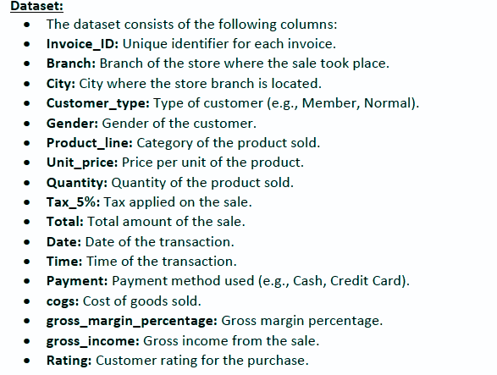

Dataset

Slide 5
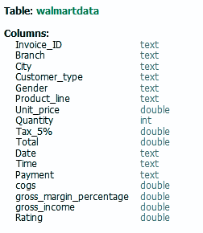

Actual Data Types with Columns

Slide 6


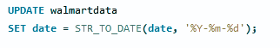
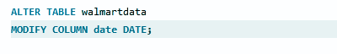
Date formate changing:
Update Statement
Alter Statement

Slide 7
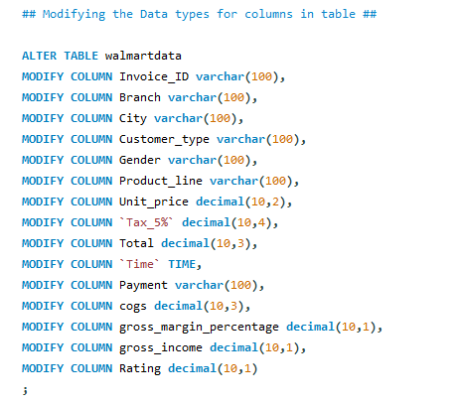

Modifying Data types

Slide 8
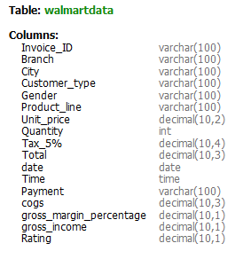

After changing data types with columns

Slide 9
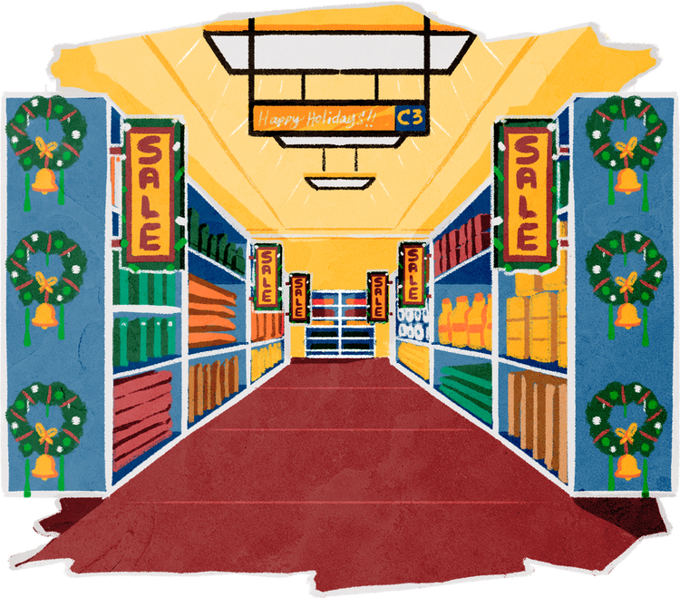
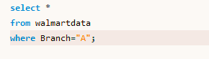
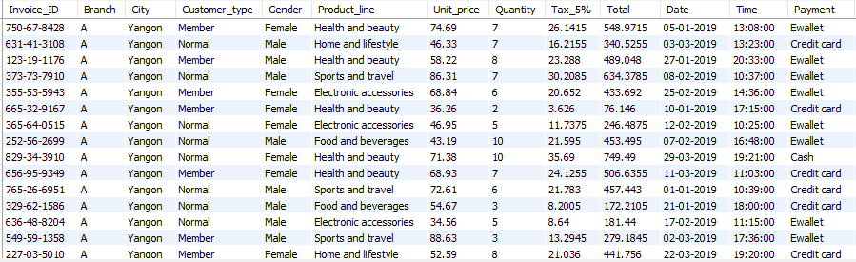
1.Retrieve all sales columns for a specific branch (e.g., Branch 'A').
Query
Results

Slide 10

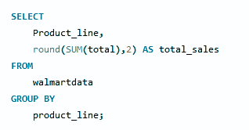
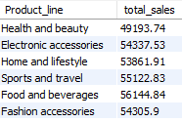
2. Find the total sales for each product line
Query
Results

Slide 11
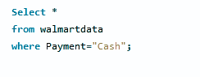

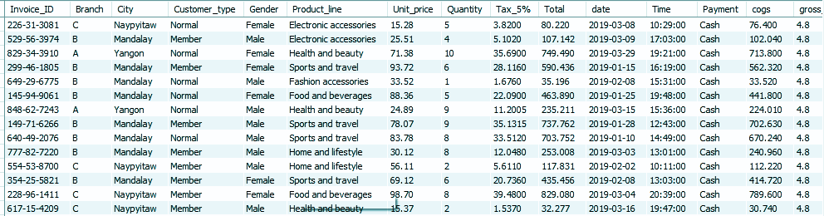
3.Retrieve all rows from the Walmart dataset where the payment method is "Cash".
Query
Results

Slide 12
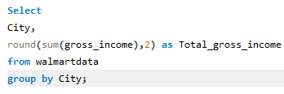


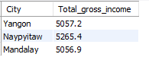
4. Calculate the total gross income generated in each city.
Query
Results

Slide 13


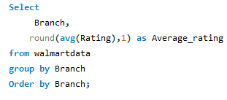
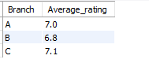
5. Find the average rating given by customers in each branch.
Query
Results

Slide 14

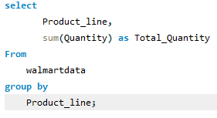
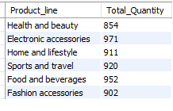
6. Determine the total quantity of each product line sold.
Query
Results

Slide 15


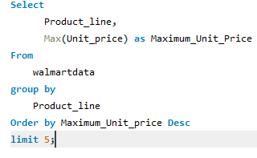
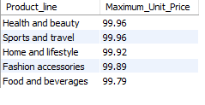
7. List the top 5 products by unit price
Query
Results

Slide 16

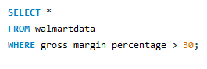
8. Find sales transactions with a gross margin percentage greater than 30%.
Query
Results

Slide 17
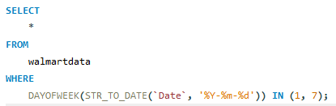

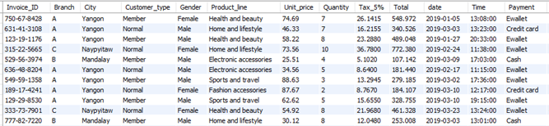
9. Retrieve sales transactions that occurred on weekends.
Query
Results

Slide 18
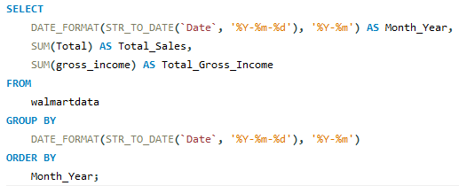

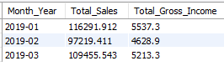
10. Calculate the total sales and gross income for each month.
Query
Results

Slide 19

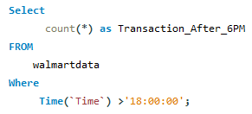
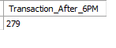
11. Find the number of sales transactions that occurred after 6 PM.
Query
Results

Slide 20
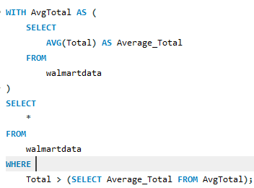

12. List the sales transactions that have a higher total than the average total of all transactions.
Query

Slide 21
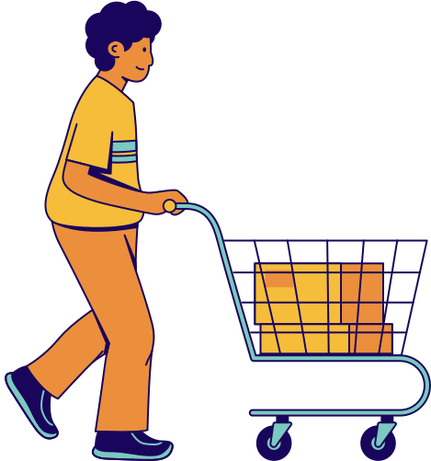
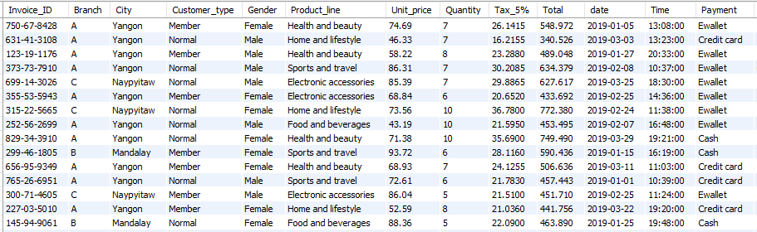
Results

Slide 22
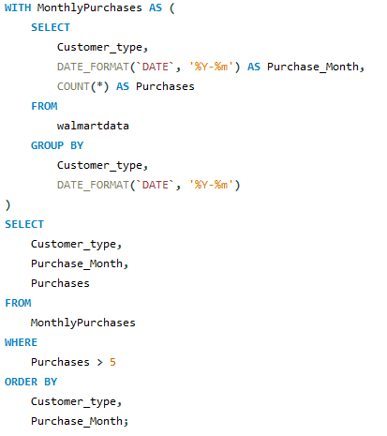


13. Find customers who made more than 5 purchases in a single month.

Slide 23

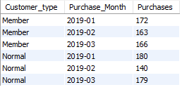
Results

Slide 24


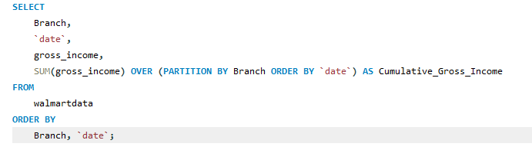
14. Calculate the cumulative gross income for each branch by date.
Query

Slide 25

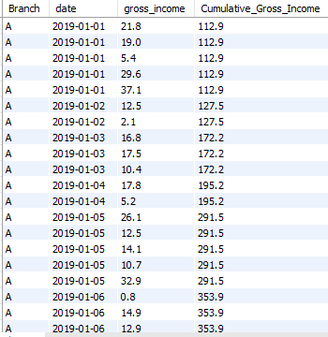
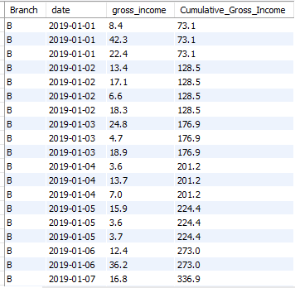
Results

Slide 26
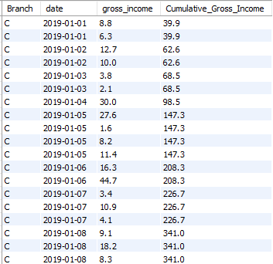
Results:

Slide 27


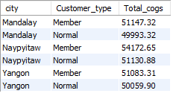
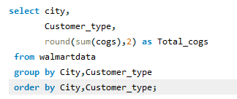
15. Find the total cogs for each customer type in each city.
Query
Results

Slide 28

Insights
1.Branch Transactions:
Top: Branch A has the most transactions, showing strong customer engagement.
Lowest: Branch C has the fewest transactions, indicating less customer activity.
2. Branch Ranking:
Highest: Branch C (7.1) has the best customer satisfaction rating.
Lowest: Branch B (6.8) has a lower rating, suggesting a need for improvement.
3. Product Line Sales:
Top: Electronics and Accessories sold the most units (971), showing high demand.
Lowest: Health and Beauty sold the fewest units, indicating lower interest or potential inventory issues.
4. Cash Transactions: Heavy reliance on cash may suggest customer preferences or limited use of digital payments.

Slide 29
Insights
5.Gross Income by City:
Highest: Naypyitaw earned $5,265.40, reflecting strong performance.
Lowest: Yangon earned $5,057.20, showing potential for growth.
6. Weekend Activity: 297 transactions occurred on weekends, indicating high customer activity.
7. Monthly Sales:
Top: January 2019 had the highest sales ($116,291.91) and gross income ($5,537.30).
Lowest: February 2019 had the lowest sales ($97,219.41) and gross income ($4,628.90).
8. Customer Purchases Analysis: Normal customer purchases peaked in January, dropped in February, and then rose again in March. Member purchases saw a decrease in February but recovered in March.

Slide 30


Recommendations
Boost February Sales: Run promotions to increase sales during the low February period.
Improve Branch B: Apply successful strategies from Branch C to enhance Branch B’s performance.
Enhance Yangon Sales: Increase marketing efforts to grow sales in Yangon.
Optimize Weekends: Increase staffing and inventory for the high weekend transaction volume.
Promote High Performers: Focus on selling Electronics and Accessories more, and improve Health and Beauty sales.
Adjust Strategies Regularly: Continuously monitor sales data and adjust strategies to improve performance.

Slide 31
Thank you
Bhupal Maruchetty

